Slide 1
Lending Club Case Study

Slide 2
Problem Statement
Consumer Finance Company which specializes lending various types of loans to Urban customers. Finance Company receives a loan applications from the customers. Based on the Customer past records and parameters, company has to take a decision whether to approve the loan or reject the loan.
Two types of risks are associated with the bank’s decision: If the applicant is likely to repay the loan, then not approving the loan results in a loss of business to the company
If the applicant is not likely to repay the loan, i.e. he/she is likely to default, then approving the loan may lead to a financial loss for the company

Slide 3
Business Objective
This company is the largest online loan marketplace, facilitating personal loans, business loans, and financing of medical procedures. Borrowers can easily access lower interest rate loans through a fast online interface.
Like most other lending companies, lending loans to ‘risky’ applicants is the largest source of financial loss (called credit loss). Credit loss is the amount of money lost by the lender when the borrower refuses to pay or runs away with the money owed. In other words, borrowers who default cause the largest amount of loss to the lenders. In this case, the customers labelled as 'charged-off' are the 'defaulters'.
If one is able to identify these risky loan applicants, then such loans can be reduced thereby cutting down the amount of credit loss. Identification of such applicants using EDA is the aim of this case study.
In other words, the company wants to understand the driving factors (or driver variables) behind loan default, i.e. the variables which are strong indicators of default. The company can utilise this knowledge for its portfolio and risk assessment.

Slide 4
Exploratory Data Analysis (EDA) Approach
In order to analyze the data we have to follow certain rules to understand the data and apply some of the analysis methods to extract the data which helps business to use the data to predict the loan defaulters.
Following is the one of the flow used to apply EDA on the loan dataset
Data Sourcing
Understand the Data
Data Cleaning and Processing
Apply EDA
Gather the data from Private or Public source
Use python libraries to understand the data
Use some of the techniques to clean the data.
Fix the missing values
Derive new columns
Apply Techniques like
Univariate
BiVariate
Multi Variate

Slide 5
Common TAKE AWAYS on Dataset After Analysis
Take Aways:
Most number of loan issued in the year of 2011. There are more than 20000 loans are issued in the year of 2011.
Most of the loans are issued in the month of December. More than 4000+ loans issued in the month of December across all years.
Most of the customers opted for 36 month payment loan.
Employee who has more than 10 years experience has taken most loans.
Most of the loans have given between 5000 to 15000.
Most of the people are paying 180 to 420 as monthly installments.
Most of the people has dti ratio between 8% and 18% of their income salary
There are many customers who paid the amount in time.
Most people credit lines are between 6 and 12.

Slide 6
Common TAKE AWAYS on Dataset After Analysis (Contd…)
Most of the people has zero derogatory public records.
Most people paying interest rate between 677 to 2800.
Grade B customers has taken more loans. Grade A is next taken more loans
Customers who are in RENT and MORTGAGE the home have took more loans
Most customers took loan for debt consolidation

Slide 7
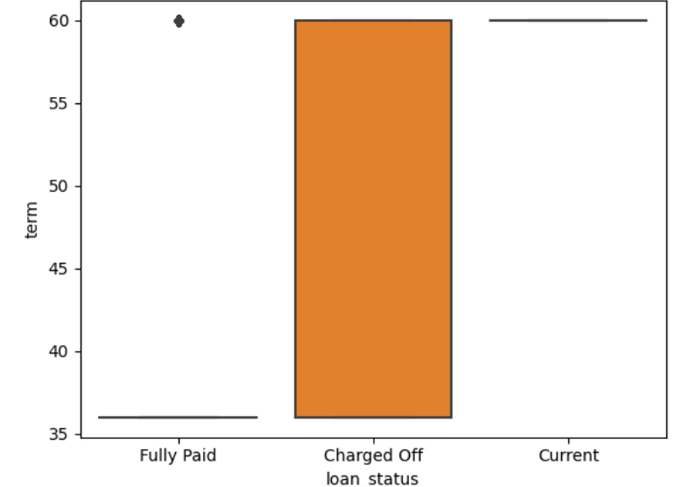
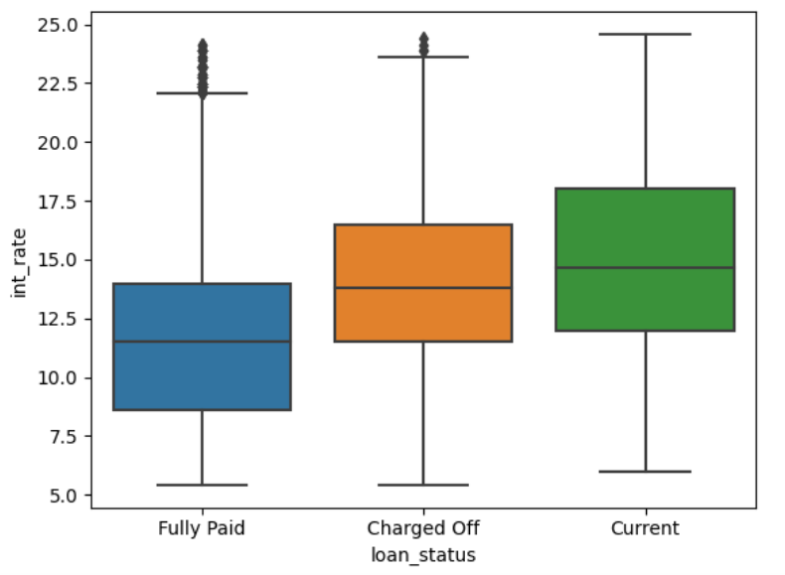
Predict Defaulters using EDA Analysis
If term is higher than there are a chances that customer might become as defaulter.
Usually, people pick the higher term because of heavy loans. Since the interest rate or EMI is more on monthly basis for higher loans, customers couldn’t be able to pay the loan EMI and become a defaulters
If interest rate is higher than there are a chances that customer might become as defaulter.
People will take small or heavy loans. But if interest rates are higher then they couldn’t be able to clear the loan with in short time due to higher interest rates.

Slide 8
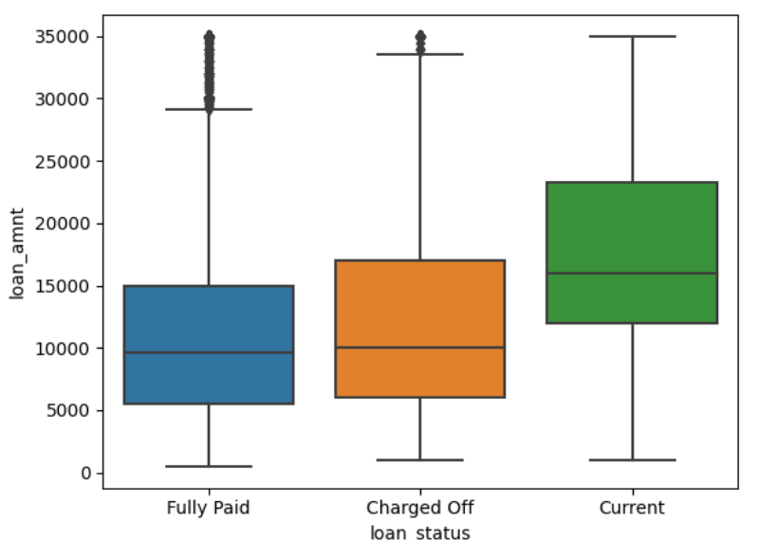
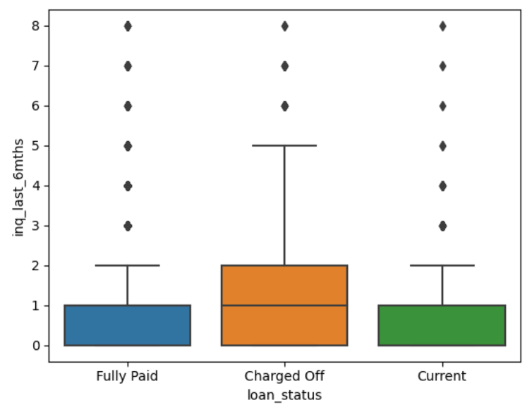
Predict Defaulters using EDA Analysis
If loan amount is higher than there are a chances that customer might become as defaulter.
Customers who opted for higher loan amount couldn’t be able to pay back due to loan amount is high or interest amount or term is higher.
Who ever done more Enquires in last 6 months, then the loan will get to defaulter.
This might be more enquiries are related to get extension where people who cannot pay the money back or might be general enquires about the loan.

Slide 9
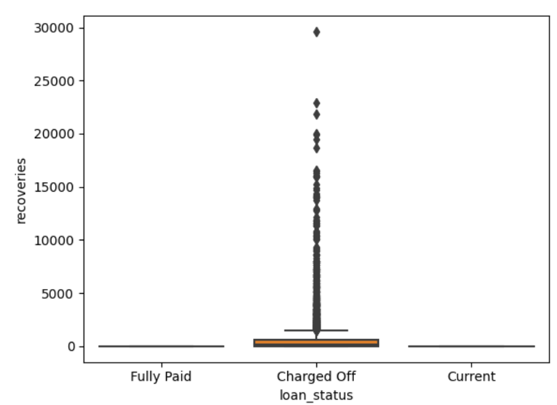
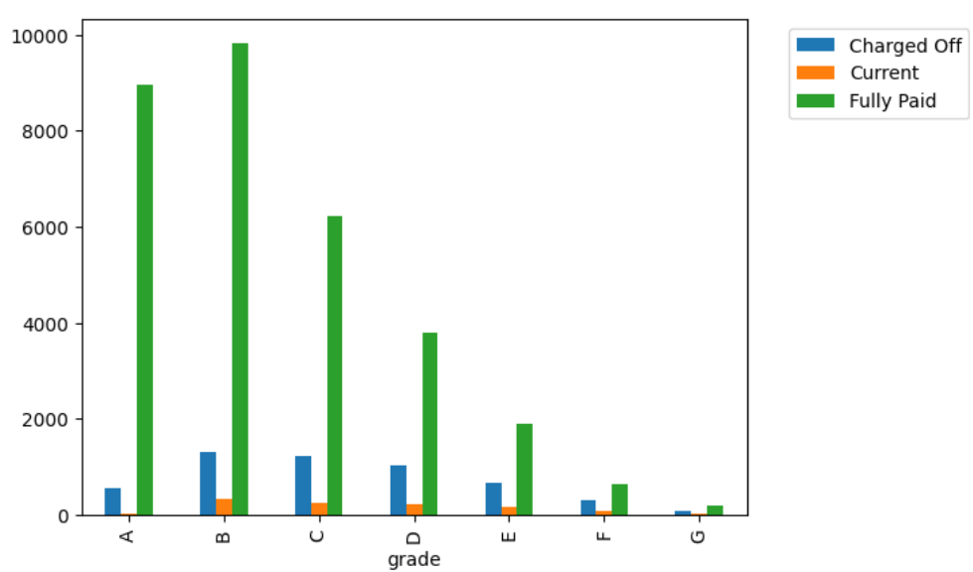
Predict Defaulters using EDA Analysis
If there are more number of recoveries on the loan then the customer will get to the defaulter list.
Recoveries will happen when customers are not able to pay the amount against the loan
Grade B and C customers are prone to the defaulters.
Finance company should be careful when issuing the loans to Grade B and C customers

Slide 10
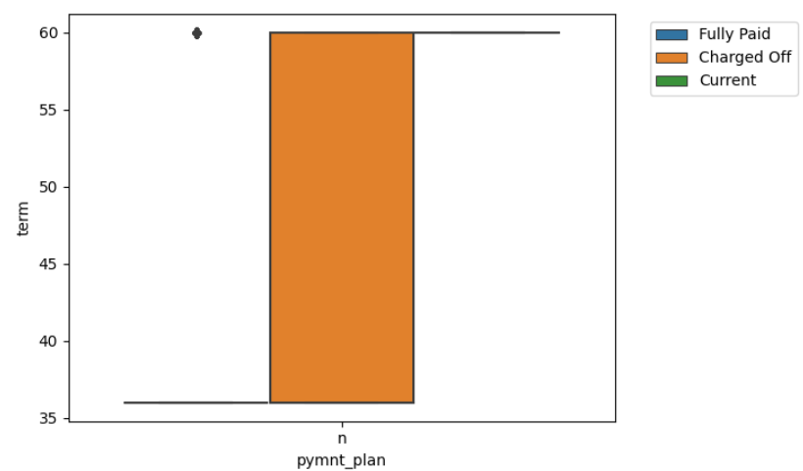
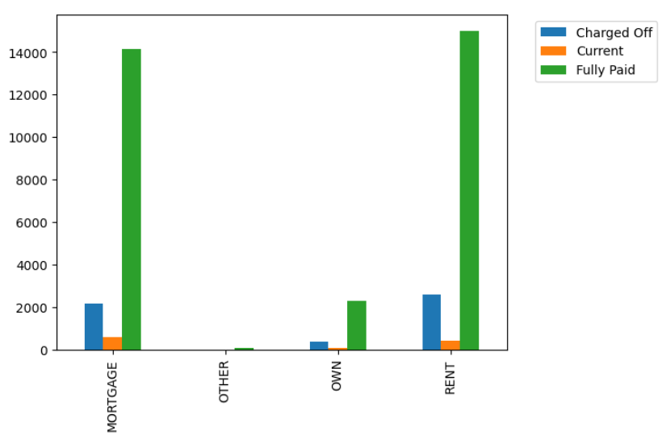
Predict Defaulters using EDA Analysis
If Payment plan is higher and term is higher then customers will prone to defaulters
Mortgage and Rent customers are prone to the defaulters.
Customers who are in rent or mortgage couldn’t be able to pay back the money due to certain situations.

Slide 11

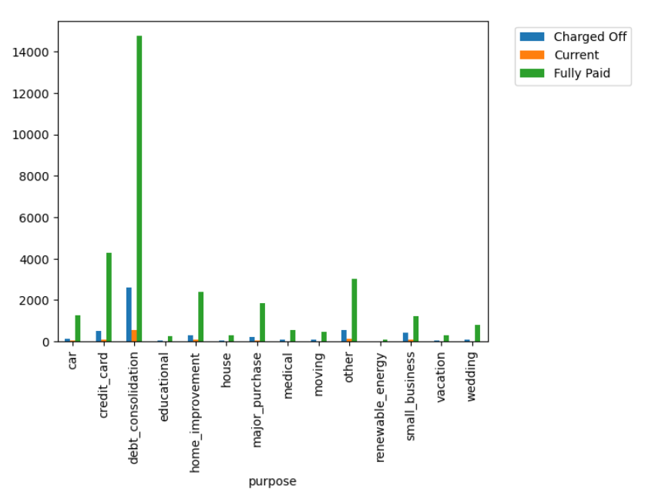
Predict Defaulters using EDA Analysis
If customers are individuals and term is higher then customers will prone to the defaulters
Customers who took the loan for the purpose of “debt consolidation” are prone to the defaulters.

